Slide 1

Laurent Mundell

Slide 2

Introduction
Since the beginning of any form of media sharing rather it be a newspaper, radio, or website there have been people who tried to trick or deceive others with lies.
Recently popularize by Donald Trump, I set out to fix an age-old problem by detecting rather an online article is a fake or reliable news source.
https://dictionary.cambridge.org/us/dictionary/english/fake-news

Slide 3

How Articles Were Chosen & Classified
The original dataset from Kaggle provided ~ 20000 source of equal balance of reliable and fake news articles.
Buzzfeed provided a list of 8000 fake news articles along with impact metrics.
Reliable news sources were picked by taking a vim diagram of two sources and only scraping from media outlets that appeared as reliable in both sources.

Slide 4
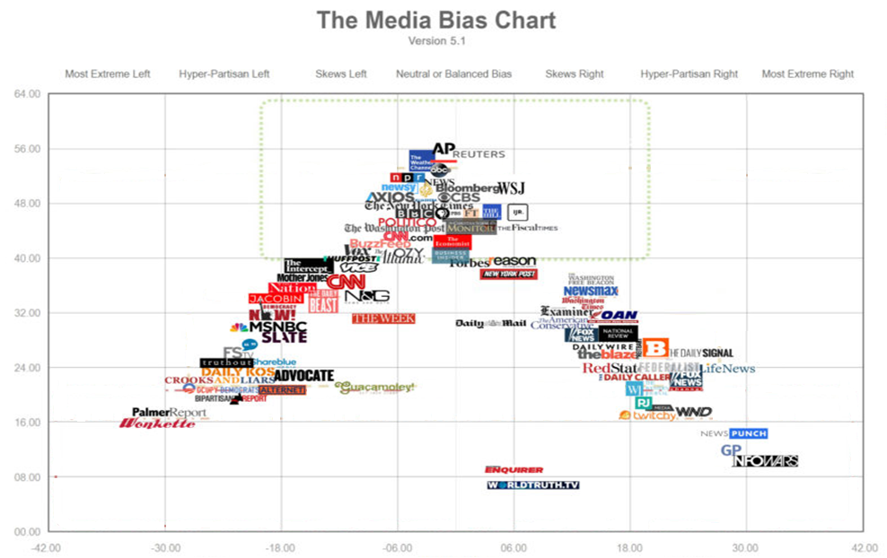
Area of focus
&
most reliable sources
More Reliable
Reliability
Less Reliable
0.0
Left
Political Bias
Right
https://www.adfontesmedia.com/?v=402f03a963ba

Slide 5
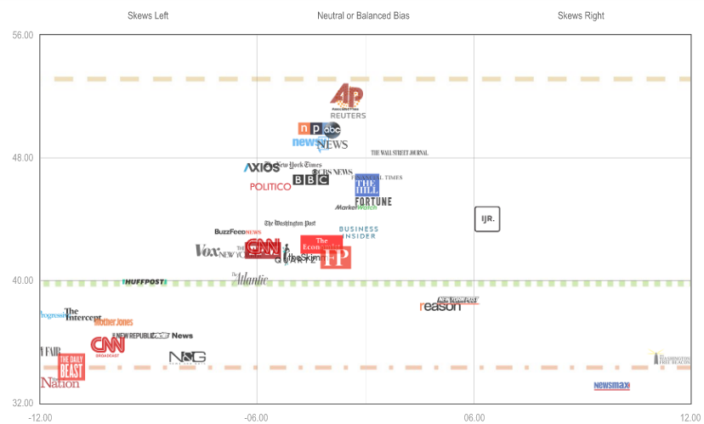
More Reliable
Reliability
Less Reliable
Left
Political Bias
Right
https://www.adfontesmedia.com/?v=402f03a963ba

Slide 6

10 Journalism Brands Where You Find Real Facts Rather Than Alternative Facts
The New York Times
The Wall Street Journal
The Washington Post
BBC
The Economist
The New Yorker
Wire Services: The Associated Press, Reuters, Bloomberg News
Foreign Affairs
The Atlantic
Politico
https://www.forbes.com/sites/berlinschoolofcreativeleadership/2017/02/01/10-journalism-brands-where-you-will-find-real-facts-rather-than-alternative-facts/#146d12dae9b5

Slide 7




Slide 8
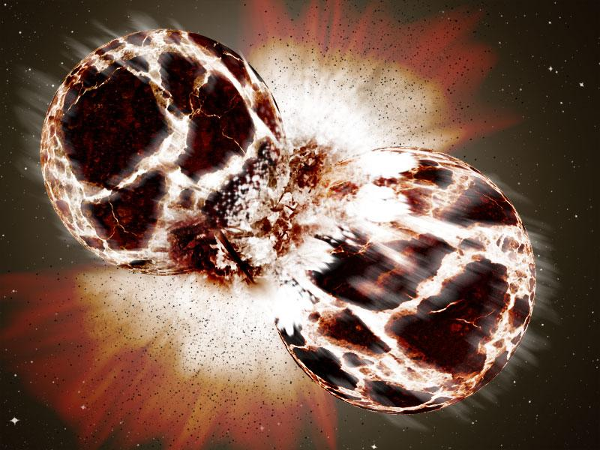

Slide 9
8 Sources for Reliable News
The New Yorker
The New York Times
The Wall Street Journal
The Economist
BBC
Huffpost
The Washington Post
The Atlantic
Ad Fontes Media

Slide 10

Demo
Step one: Provide a URL to a web article.
Example: https://www.nytimes.com/2020/04/13/us/politics/trump-daily-coronavirus-briefing.html
Step 2: Press the enter / submit button
Results
URL
Submit
The article is real.

Slide 11

https://i-found-you-faker.herokuapp.com/

Slide 12
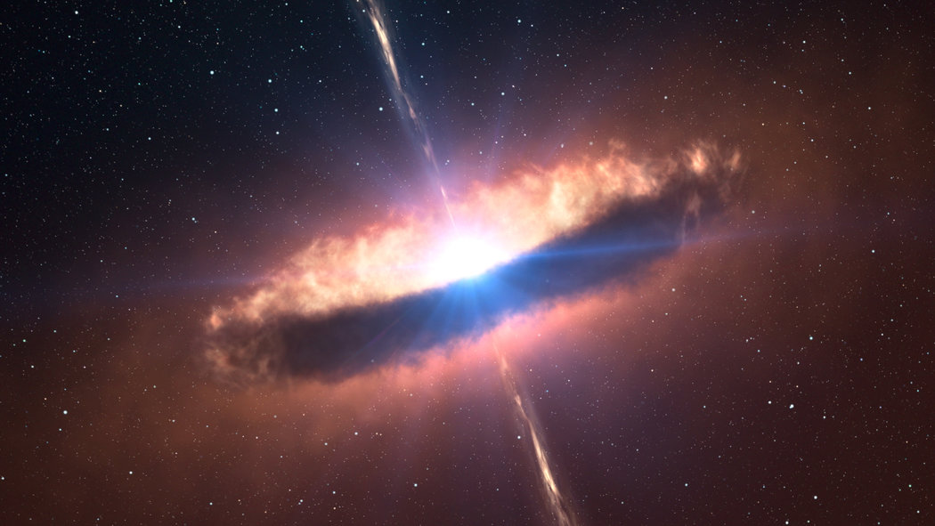
Results
The model got an 99.97824% accuracy when classifying articles it hasn’t seen.

Slide 13
Results
Donald Trump can rest easy knowing fake news cannot hide….

Slide 14

QUESTIONS?

Slide 15
Links
https://www.kaggle.com/c/fake-news/data
https://www.kaggle.com/rmisra/news-category-dataset
https://libguides.library.kent.edu/c.php?g=278400&p=1854632
https://www.forbes.com/sites/berlinschoolofcreativeleadership/2017/02/01/10-journalism-brands-where-you-will-find-real-facts-rather-than-alternative-facts/#82973b6e9b5a
https://www.adfontesmedia.com/interactive-media-bias-chart/?v=402f03a963ba

Slide 16
Links
https://github.com/BuzzFeedNews/2018-12-fake-news-top-50
https://www.buzzfeednews.com/article/craigsilverman/facebook-fake-news-hits-2018
https://www.kaggle.com/nzalake52/new-york-times-articles
https://www.kaggle.com/plarmuseau/minimalistic-logistic-ngram-tfidf-lb-0-975

Slide 17
Data Sources
Kaggle
https://www.kaggle.com/c/fake-news/data
https://www.kaggle.com/rmisra/news-category-dataset
https://www.kaggle.com/nzalake52/new-york-times-articles
Buzzfeed
https://github.com/BuzzFeedNews/2018-12-fake-news-top-50

